Slide 1
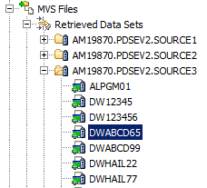
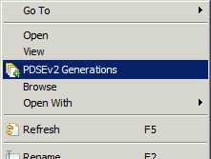
Today
By member only
Stats do not match TSO

Slide 2
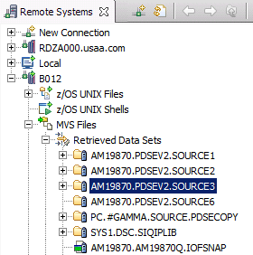
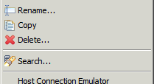
General idea: DSC PDSEv2 view
Data Set Commander
Have menu items with DSC options that make sense
Update titles
Filter/Sort by Userkey
Search
Etc.
Name | Last Modified | Title | Size | Userkey | Userid
DWABCD01 | March 21, 2017 3:37:37 CDT | FIRE OTHER STRUCTURES COVERAGE | 665 | 20081225 | AM19870
DWABCF22 | March 21, 2017 1:15:22 CDT | RENTERS ANTI-THEFT SERVICE 2 | 1004 | 20100115 | IV23456
DWABCE55 | March 20, 2017 13:11:11 CDT | EXAMPLE of MIXed case TiTlEs | 560 |  | AM19870
DWABCJ77 | March 19, 2017 14:37:35 CDT |  | 51 |  | AM19870
DWABCH33 | August 15, 2008 08:15:00 CDT | FIRE WIND AND HAIL DEDUCTIBLE | 762 | 20170315 | IV34623

Slide 3
General idea: DSC Member view
Data Set Commander
Generation Number | Last Modified | Size | Userid
0 | March 21, 2017 3:37:37 CDT | 65 | AM19870
-1 | March 21, 2017 1:15:22 CDT | 69 | AM19870
-2 | March 20, 2017 13:11:11 CDT | 60 | AM19870
-3 | March 19, 2017 14:37:35 CDT | 51 | AM19870
-4 | March 18, 2017 3:30:32 CDT | 45 | GY34568
-5 | March 17, 2017 22:10:44 CDT | 45 | GY34568
-6 | March 10, 2017 10:29:02 CDT | 45 | PL89734
-7 | January 21, 2017 3:37:37 CDT | 55 | PL89734
-8 | August 15, 2008 08:15:00 CDT | 50 | IV34623

