Slide 1
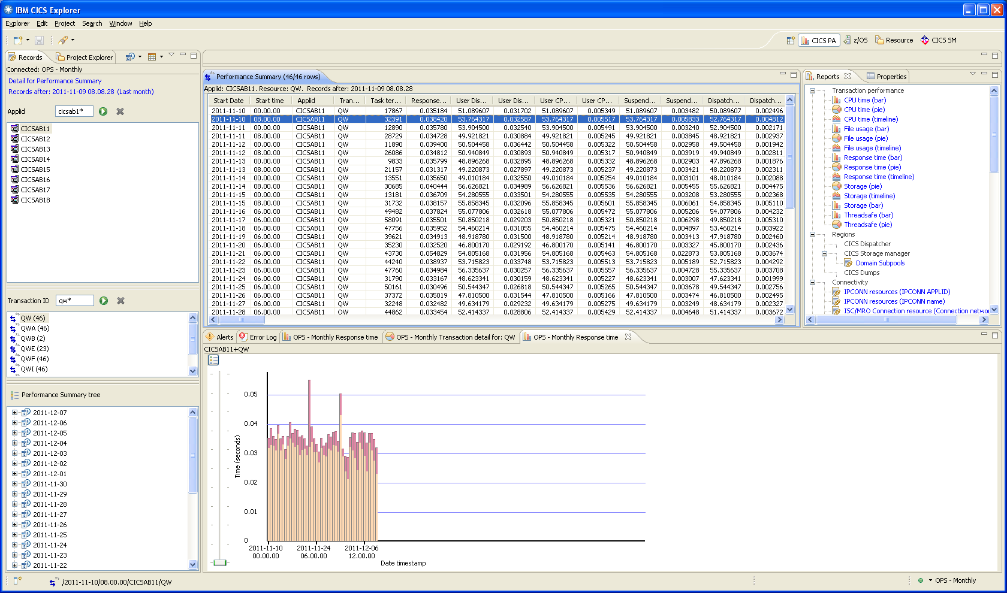
Select this by down or up arrow should change the view below
Notes:
So, using the arrow key (or other possibly) when navigating in the top tab (Performance Summary) have the lower tab automatically display the selected day view. Otherwise, the user has to right click/Performance History/Response Time for each row selected. Using my suggested approach will allow the quicker viewing of the Performance History graphic.

