Slide 1
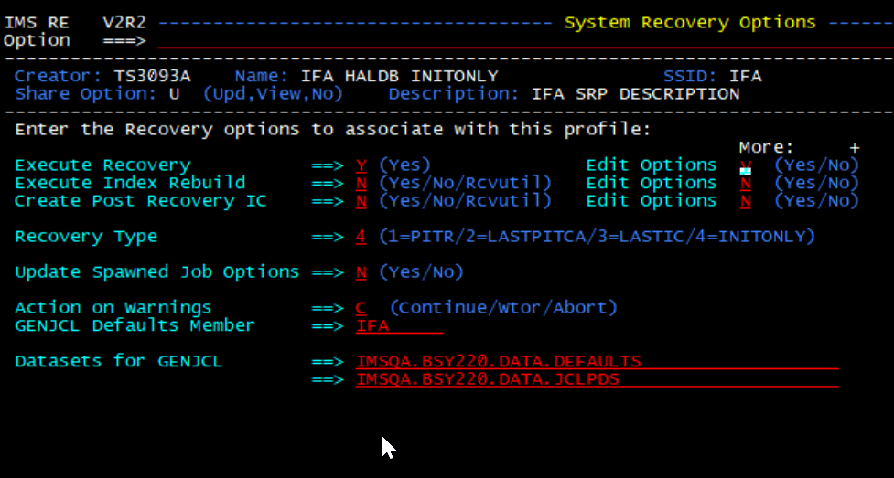
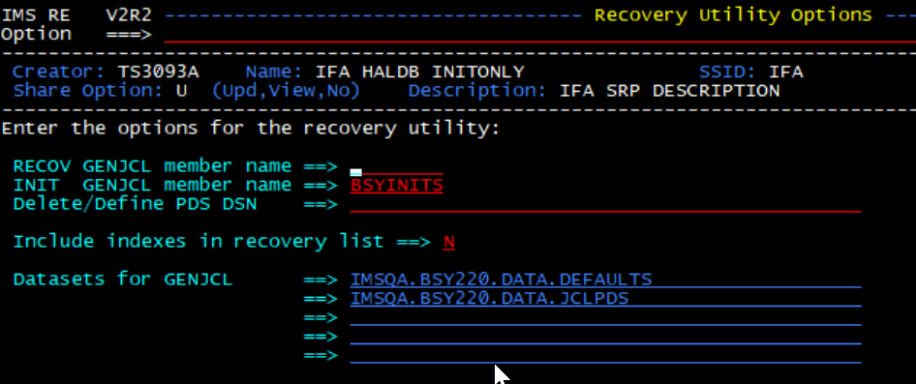
1. Current setting
I suppose that the current setting for system recovery profile is like this.

Slide 2
2. Add index DBDS to the system recovery profile
On ‘System Recovery Profile’ panel, add index DBDS to the system recovery profile.

Slide 3
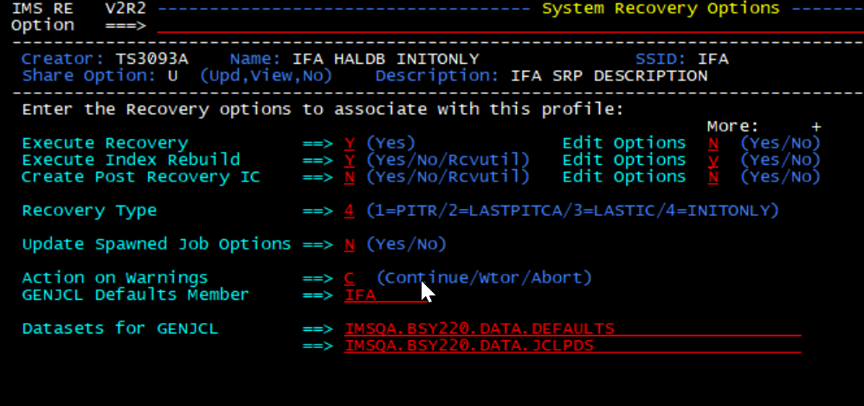
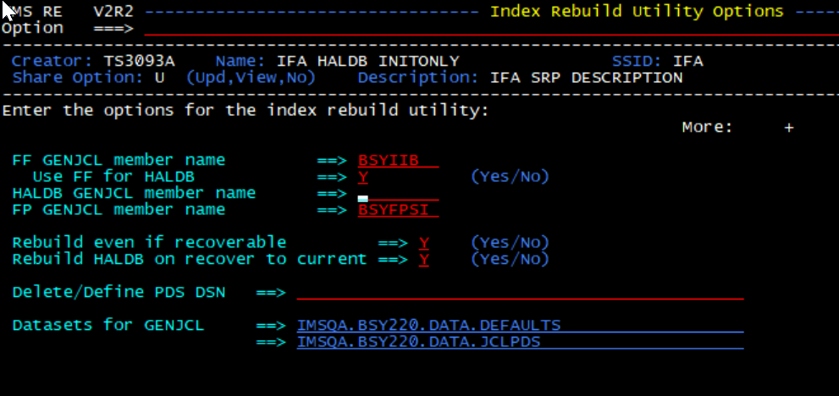
3. Add index building step for the System Recovery Options
If you set ‘Execute Index Rebuild’ to ‘Y’, IMS RE generates also index building job step (maybe separate job) according to ‘Index Rebuild utility Option’ setting.

