Slide 1

for XXX – provided by ZZZ

Slide 2
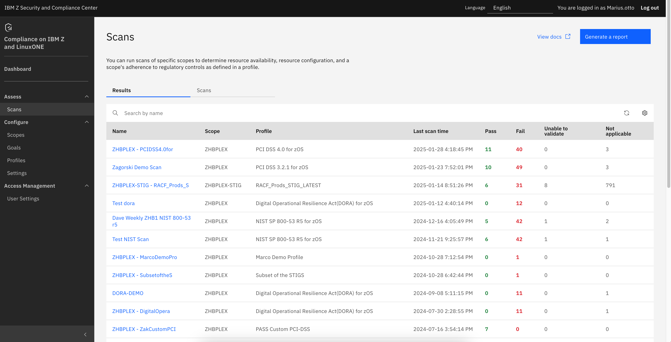
for XXX – provided by ZZZ

