Slide 1
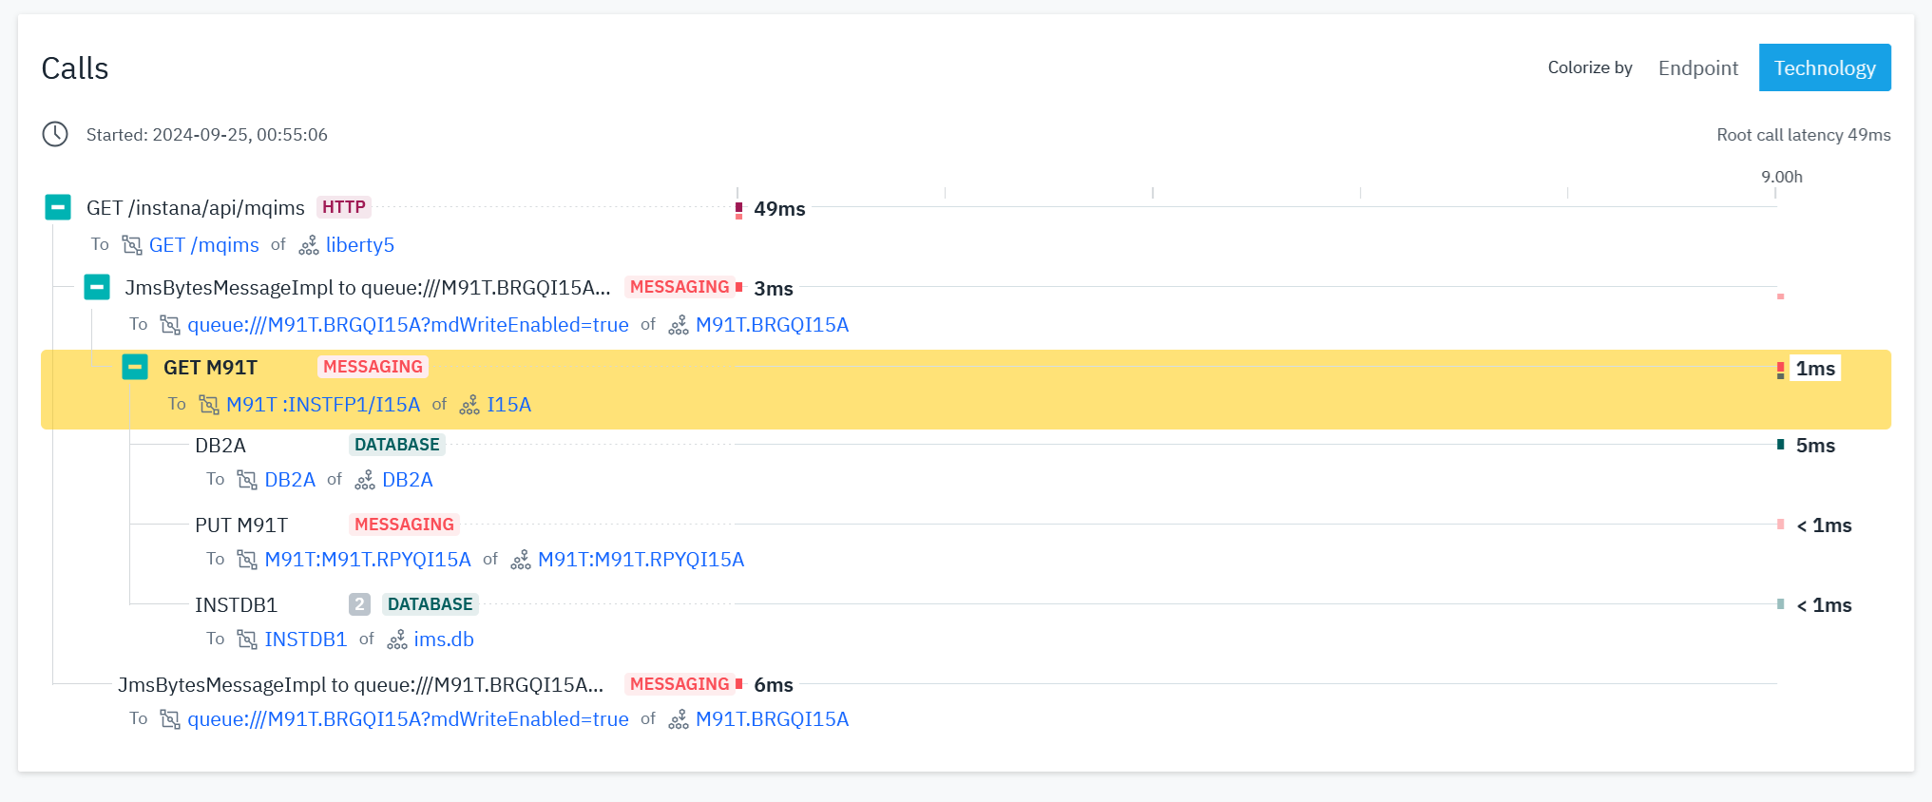
Instana Panel for IMS Application (IMS-MQ Bridge)
Application flow
HTTP => MQ => MQ for z/OS => IMS-MQ Bridge => IMS/DC => IMS FP DEDB
HTTP => MQ => MQ for z/OS => IMS-MQ Bridge => IMS/DC => DB2
We cannot see abend code

Slide 2
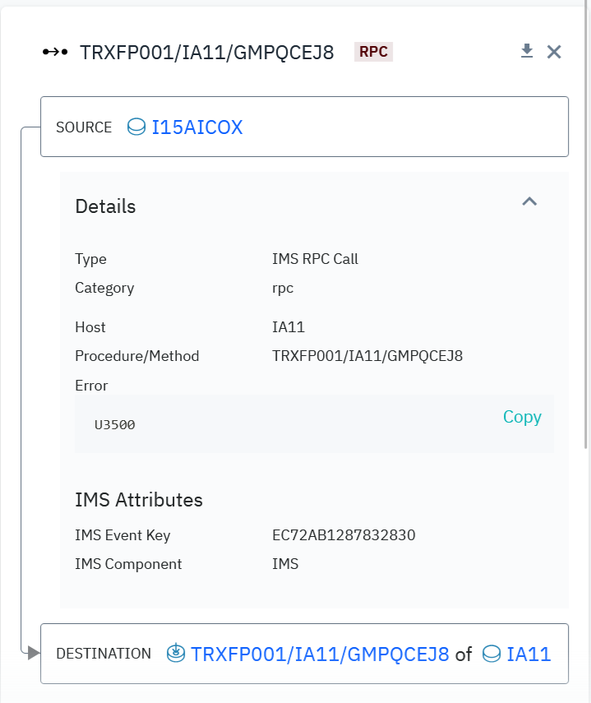
Instana Panel for IMS Application (z/OS Connect)
Instana show error code

